Slide 1


AGRO-INTELLIGENT SYSTEM USING
MACHINE LEARNING
BY
SRIRAJA.B (19104157)
TAMIL SELVAN.S (19104165)
THAVAPRAKASH.S(19104167)
VIGNESH.K (19104170)
Guided By
T.K.P.Rajagopal
Asst.Professor
Department of CSE

Slide 2
Abstract
Nowadays the population of our country is growing continuously. So, the need for the food is increasing so production of the crops is increasing daily. On the other hand, the productivity of crops is affected by various factors like climates change, low fertility soil, etc.
In India, most of the crops are solely dependent upon weather conditions. Hence, more yield of crops can be achieved by analysing agro-climate data using machine learning techniques.
This purposed system purposes the method to identify the suitable crop based on the climate and soil factors to increase the crop production.

Slide 3
Abstract
It also predicts the crop yield based on the factors and also fertilizer advisor. Soil parameters like soil type, soil pH, soil fertility and the weather parameters such as temperature, humidity and rainfall are used in this project.
Where weather parameters like temperature, humidity and Rainfall are taken from Weather API.
We use machine learning algorithm like Random Forest classification algorithm for crop recommendation.

Slide 4
Abstract
We use Random Forest Regression algorithm for crop yield prediction.
The outcomes of algorithm give best accuracy scores and finally deployment to website using flask python web framework.
This purposed system will help the farmer to plant a sowing crop based on the weather and soil parameter and advice fertilizer based on the soil fertility.
It also suggests the crop yield production based on weather parameter

Slide 5
Introduction
Machine Learning
Machine learning (ML) is the study of computer algorithms that can improve automatically through experience and by the use of data.
It is seen as a part of artificial intelligence. Machine learning algorithms build a model based on sample data, known as training data, in order to make predictions or decisions without being explicitly programmed to do so.
Machine learning algorithms are used in a wide variety of applications, such as in medicine, email filtering, speech recognition, and computer vision, where it is difficult or unfeasible to develop conventional algorithms to perform the needed tasks.

Slide 6
Introduction
Machine learning approaches are traditionally divided into three broad categories,
Supervised learning
Unsupervisied Learning
Semi-Supervisied Learning
Reinforcement Learning

Slide 7
Introduction
Supervised learning
Supervised learning algorithms build a mathematical model of a set of data that contains both the inputs and the desired outputs.
The data is known as training data, and consists of a set of training examples.
Each training example has one or more inputs and the desired output, also known as a supervisory signal.
In the 2 mathematical model, each training example is represented by an array or vector, sometimes called a feature vector, and the training data is represented by a matrix.

Slide 8
Introduction
Unsupervised learning
Unsupervised learning algorithms take a set of data that contains only inputs, and find structure in the data, like grouping or clustering of data points.
The algorithms, therefore, learn from test data that has not been labelled, classified or categorized.
Instead of responding to feedback, unsupervised learning algorithms identify commonalities in the data and react based on the presence or absence of such commonalities in each new piece of data.

Slide 9
Introduction
Semi-Supervised learning
Semi-supervised learning falls between unsupervised learning (without any labelled training data) and supervised learning (with completely labelled training data).
Some of the training examples are missing training labels, yet many machine-learning researchers have found that unlabelled data, when used in conjunction with a small amount of labelled data, can produce a considerable improvement in learning accuracy.

Slide 10
Introduction
Reinforcement learning
Reinforcement learning is an area of machine learning concerned with how software agents ought to take actions in an environment so as to maximize some notion of cumulative reward.
Due to its generality, the field is studied in many other disciplines, such as game theory, control theory, operations research, information theory, simulation-based optimization, multi-agent systems, swarm intelligence, statistics and genetic algorithms.
In machine learning, the environment is typically represented as a Markov decision process (MDP).

Slide 11
Introduction
Agriculture
Agriculture is the practice of cultivating plants and livestock. Agriculture was the key development in the rise of sedentary human civilization, whereby farming of domesticated species created food surpluses that enabled people to live in cities.
The history of agriculture began thousands of years ago. After gathering wild grains beginning at least 105,000 years ago, nascent farmers began to plant them around 11,500 years ago. Pigs, sheep, and cattle were domesticated over 10,000 years ago.
Plants were independently cultivated in at least 11 regions of the world. Industrial agriculture based on large-scale monoculture in the twentieth century came to dominate agricultural output, though about 2 billion people still depended on subsistence agriculture.

Slide 12
Introduction
Agriculture
Plants were independently cultivated in at least 11 regions of the world. Industrial agriculture based on large-scale monoculture in the twentieth century came to dominate agricultural output, though about 2 billion people still depended on subsistence agriculture.
The major agricultural products can be broadly grouped into foods, fibres, fuels and raw materials (such as rubber).
Food classes include cereals (grains), vegetables, fruits, oils, meat, milk, eggs and fungi.

Slide 13
Introduction
Machine learning in agriculture
Machine learning is evolving along with big data technologies and other fast computing devices.
They are growing to create new opportunities to understand the various data processes related to the environmental functions of agriculture.
Machine learning can be defined as the scientific method that will allow machines the ability to learn without programming the devices.
Machine learning is used in various scientific areas such as Bioinformatics, Biochemistry, Medicines, Meteorology, Economic Sciences, Robotics, Food Security and Climatology.

Slide 14
Introduction
Owing to increasing population, the demand for crop production is
increasing. On the other hand, the available land area for agriculture is decreasing
day by day.
Moreover, one-third of the total food is wasted due to various factors
such as climate change, selection of unsuitable crop, low fertile soil, pest, etc.
Crop yield rate depends upon various parameters such as the
geography of area, soil type, soil nutrients, soil pH value, weather condition, etc.
The combination of these parameters can be used for selection
of suitable crops for a farm or land to gain maximum yield.
In this manuscript, soil and weather parameters such as soil type,
soil fertility, soil pH, maximum temperature, minimum temperature, rainfall are
used to identify suitable crops for specified farm or land
Design and Development of crop sowing recommending system
using machine learning which helps the farmer to increase yield and subsequent profit of
Agriculture production

Slide 15
Literature Survey
S.Bhanumathi, M.Vineeth and N.Rohit, “Crop Yield Prediction
and Efficient use of Fertilizers” in International Conference on Communication
and Signal Processing
Sonal Jain and Dharavath Ramesh ,“Machine Learning convergence
for weather based crop selection” in 2020 IEEE International Students’
Conference on Electrical, Electronics and Computer Science

Slide 16
Existing system
Crop Yield Prediction and Efficient use of Fertilizers
In this paper, an effort is made in order to know the crop production analysis and is processed by implementing both the Random Forest algorithm and Backpropagation algorithm.
These models were experimented with different types of crops in various regions across India to predict the output.
Even fertilizer data was trained using the back-propagation algorithm and evaluated to get the result of how much nitrogen, phosphorus is required for the area of land.

Slide 17
Existing system
Both the models for the crop production were compared in predicting the output and by various parameters with respect to the error rate.
We compared the error rate obtained while comparing the random forest algorithm and backpropagation where we got the error rate lesser to the random forest than back propagation while predicting the output for both of the models and the compassion is plotted in the graph.
For prediction of the yield, the user will enter the data. The user should enter the details one after another.
The output of the yield prediction. The input of the fertilizer data is entered and the out of the fertilizer data

Slide 18
Existing system
Machine Learning convergence for weather based crop selection
Prediction is done for maximum temperature, minimum temperature and rainfall.
The seasonal prediction results for maximum temperature, minimum temperature and rainfall.
From prediction results, it is noted that RNN able to predict time-series data more accurately with an acceptable error.
The performance of RNN model is compared with ANN using Root Mean Square Error (RMSE) and comparison results which depicts better prediction accuracy of RNN than conventional ANN.

Slide 19
Existing system
Following weather prediction, the crop selection is done using random forest classifier.
The suggested crops for rabi season by random forest classifier based on predicted weather parameters and soil parameters of land. The proposed method also gives proper sowing time for crops and agriculture facilities required.
It can be noted that rice and maize crops grown in rabi season require irrigation facility while red gram crop can be dependent on rainfall.
The sowing time for rice and maize crop is given as third week of December and November respectively and similarly, the sowing time for red gram is given as first week of October.

Slide 20
Proposed System
The proposed methodology is divided into three phases:
1) Identification of suitable crop
2) Fertilizer Advisor
3) Crop yield prediction

Slide 21
Proposed System
Identification of suitable crop
Crop selection model which will input the soil parameters like soil type, soil pH and soil fertility, Rainfall, State and City.
The soil and weather factors are used for collectively to identify the suitable sowing crops.
The crop selection can be done either annual or seasonal.
In crop recommending method, the model recommended the one or more crops that is suitable for a weather and also recommend the crop requirement such as the proper sowing time of a particular crop based on weather parameters.

Slide 22
Proposed System
Fertilizer Advisor
Fertilizer advice model takes input of soil parameters such as soil type,
soil pH, soil fertility and the weather parameters such as temperature, humidity and rainfall.
Based on the soil values, Fertilizer Advisor is based on soil parameters to suggest how to use, if soil fertility is low then it advice use some fertilizer .
Fertilizer Advisor, the model suggests how to use fertilizer for a particular crop based on weather and soil parameter.
It suggest to improve the soil fertility value

Slide 23
Proposed System
Crop yield prediction
Crop yield prediction model takes input of state, district, crop, area, season, Production data in Table is data used to predict crop yield based on 7 factors.
Crop Yield Prediction system which will use the Random Forest Regressor machine learning algorithm to trained the model and test the model, which will outcomes Crop Yield Prediction Model.
This model will be saved, and the farmers can easily get the crop Yield by giving their farmer soil type characteristics, top soil and pH as the input to the system.
Crop yield method, the model predict the yield in Production/Kg of a particular crop based on soil and weather parameters.

Slide 24
Modules
Data Collection
Data Pre-processing
Crop Sowing Recommending Prediction
Crop Fertilizer Suggestion
Crop yield Prediction
Deployment in Flask

Slide 25
Data Collection
Kaggle is the sub brand of Google which gives the best platform to get and publish data sets.
It also allows the users to build models in an environment that is generally web-based and data-science.
We have taken our dataset from Kaggle which we have used to train our model.

Slide 26
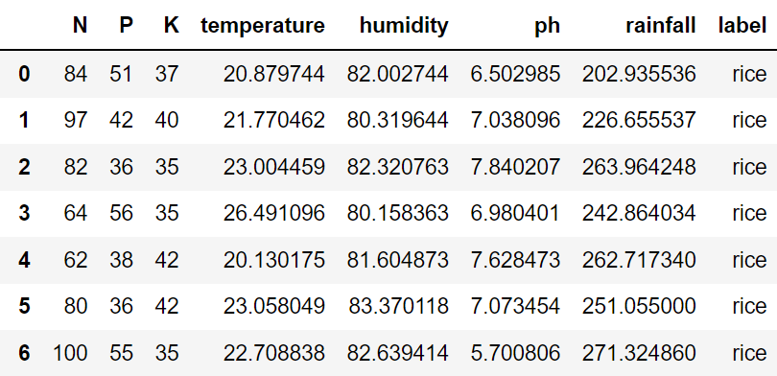
Data Collection
Crop selection model which will input the soil parameters like soil type, soil pH and soil fertility, Rainfall, State and City. The soil and weather factors are used for collectively to identify the suitable sowing crops. The sample dataset is used for the crop recommending model is shown in following Table.

Slide 27
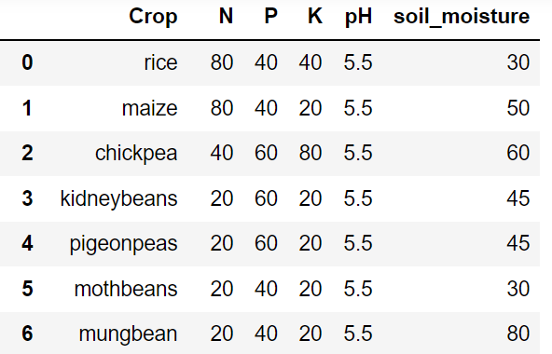
Data Collection
Fertilizer model which will input the soil parameters like soil type, soil pH and soil fertility. The soil parameters are used for collectively to show to use the fertilizer based on this soil Quality. The sample dataset is used for the Fertilizer model is shown in following Table.

Slide 28
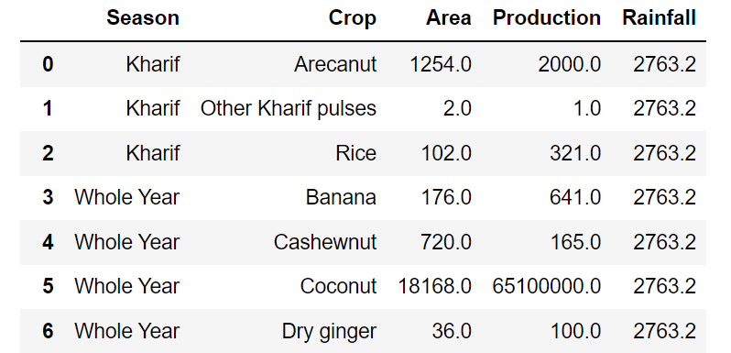
Data Collection
Crop yield prediction model which will input parameters like soil type, Crop, Area, Rainfall, State and City. The soil and weather factors are used for collectively to identify how much yield will be produced. The sample dataset is used for the crop yield prediction model is shown in following Table.

Slide 29
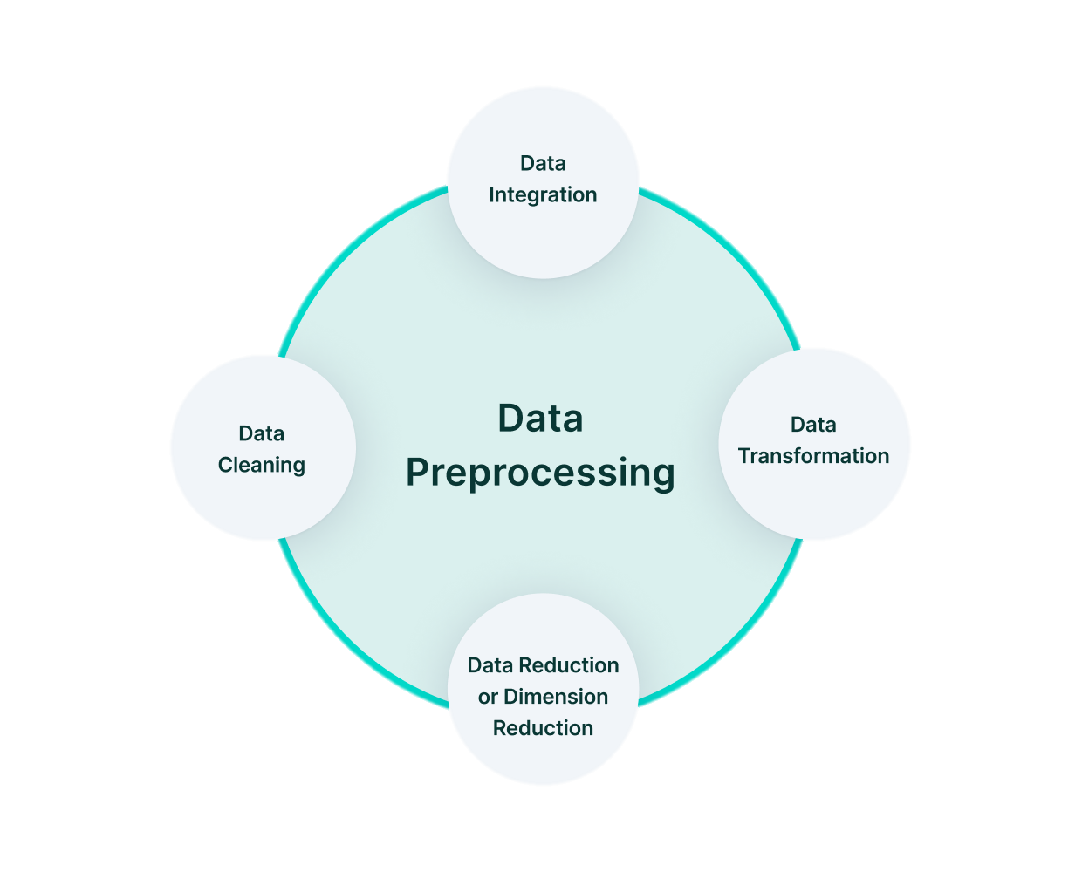
Data Pre-processing
Data preprocessing is a data mining technique which is used to transform the raw data in a useful and efficient format.

Slide 30
Crop Sowing Recommending Prediction
Crop selection model takes input of soil parameters such as soil type,
soil pH, soil fertility and the weather parameters such as temperature, humidity
and rainfall.
The sample dataset is used for the crop recommending model is shown in
following Table.

Slide 31
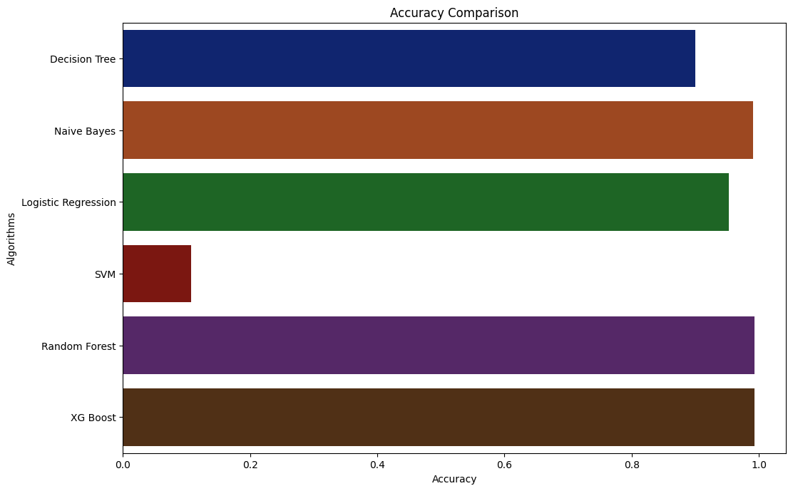
We need to consider the soil factor like Nitrogen, Phosphorous, Potassium, soil pH value and Weather parameters like Rainfall, temperature, moisture and humidity.
We use open weather API to get the current value of Rainfall, moisture, humidity by getting parameters like State and City.

Slide 32
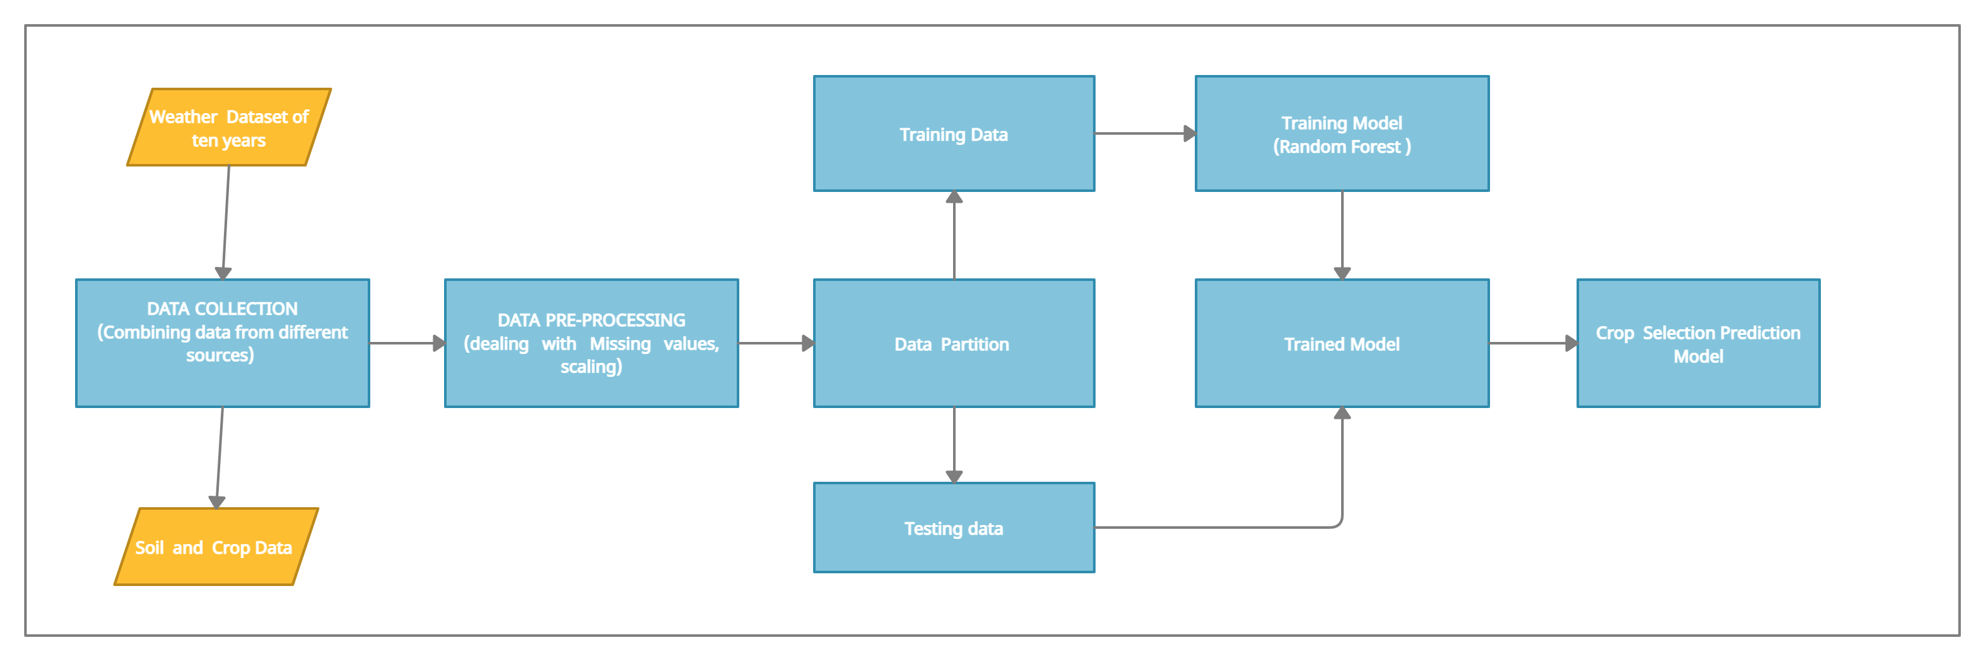
Data Flow Diagram Of Crop Recommending Model

Slide 33
After applying the different machine learning algorithms for the dataset
Random Forest Algorithm shows the best accuracy score as 99.3181818985
Crop recommending system which will use the Random Forest classification machine learning algorithm to trained the model and test the model, which will outcomes Crop Recommendation Model.
This model will be saved, and the farmers can easily get the sowing crop recommending by giving their farmer soil type characteristics, top soil and pH as the input to the system.
Crop selection method, the model suggests one or more crop that is
suitable for a season and the proper sowing time of a particular crop based
on predicted weather.

Slide 34
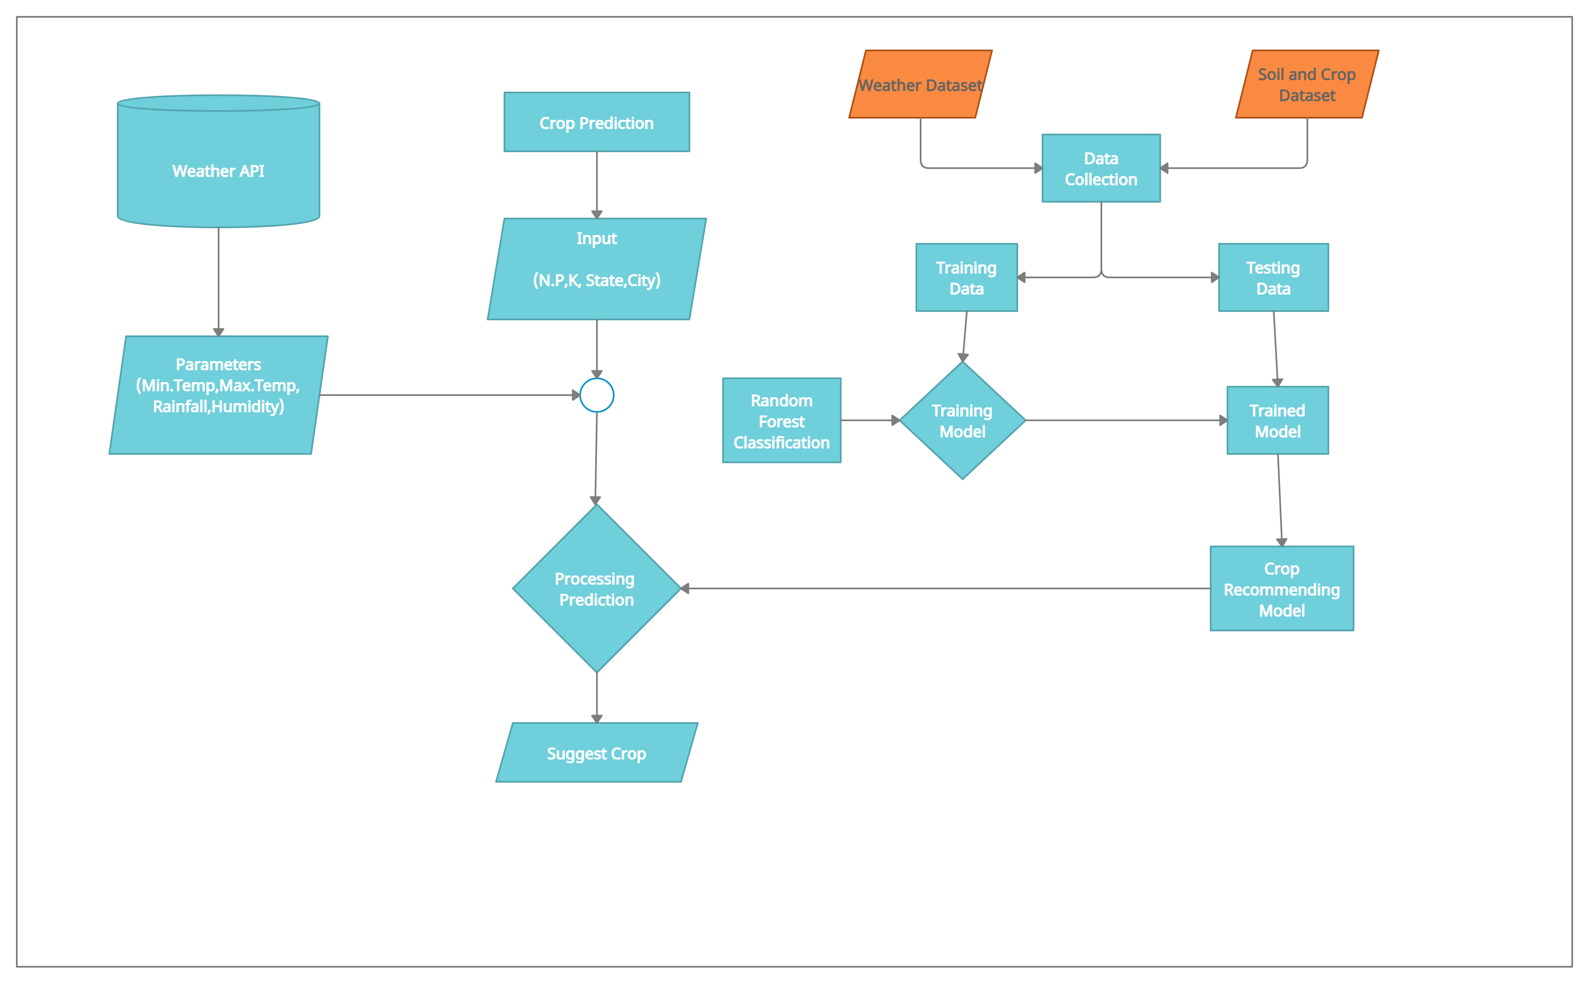
Architecture Diagram Of Crop Recommending Model

Slide 35
Crop Fertilizer Suggestion
Fertilizer advice model takes input of soil parameters such as soil type,
soil pH, soil fertility and the weather parameters such as temperature, humidity
and rainfall.
Based on the soil values, Fertilizer Advisor is based on soil parameters to
suggest how to use, if soil fertility is low then it advice use some fertilizer .
Fertilizer Advisor, the model suggests how to use fertilizer for a particular
crop based on weather and soil parameter.
It suggest to improve the soil fertility value

Slide 36
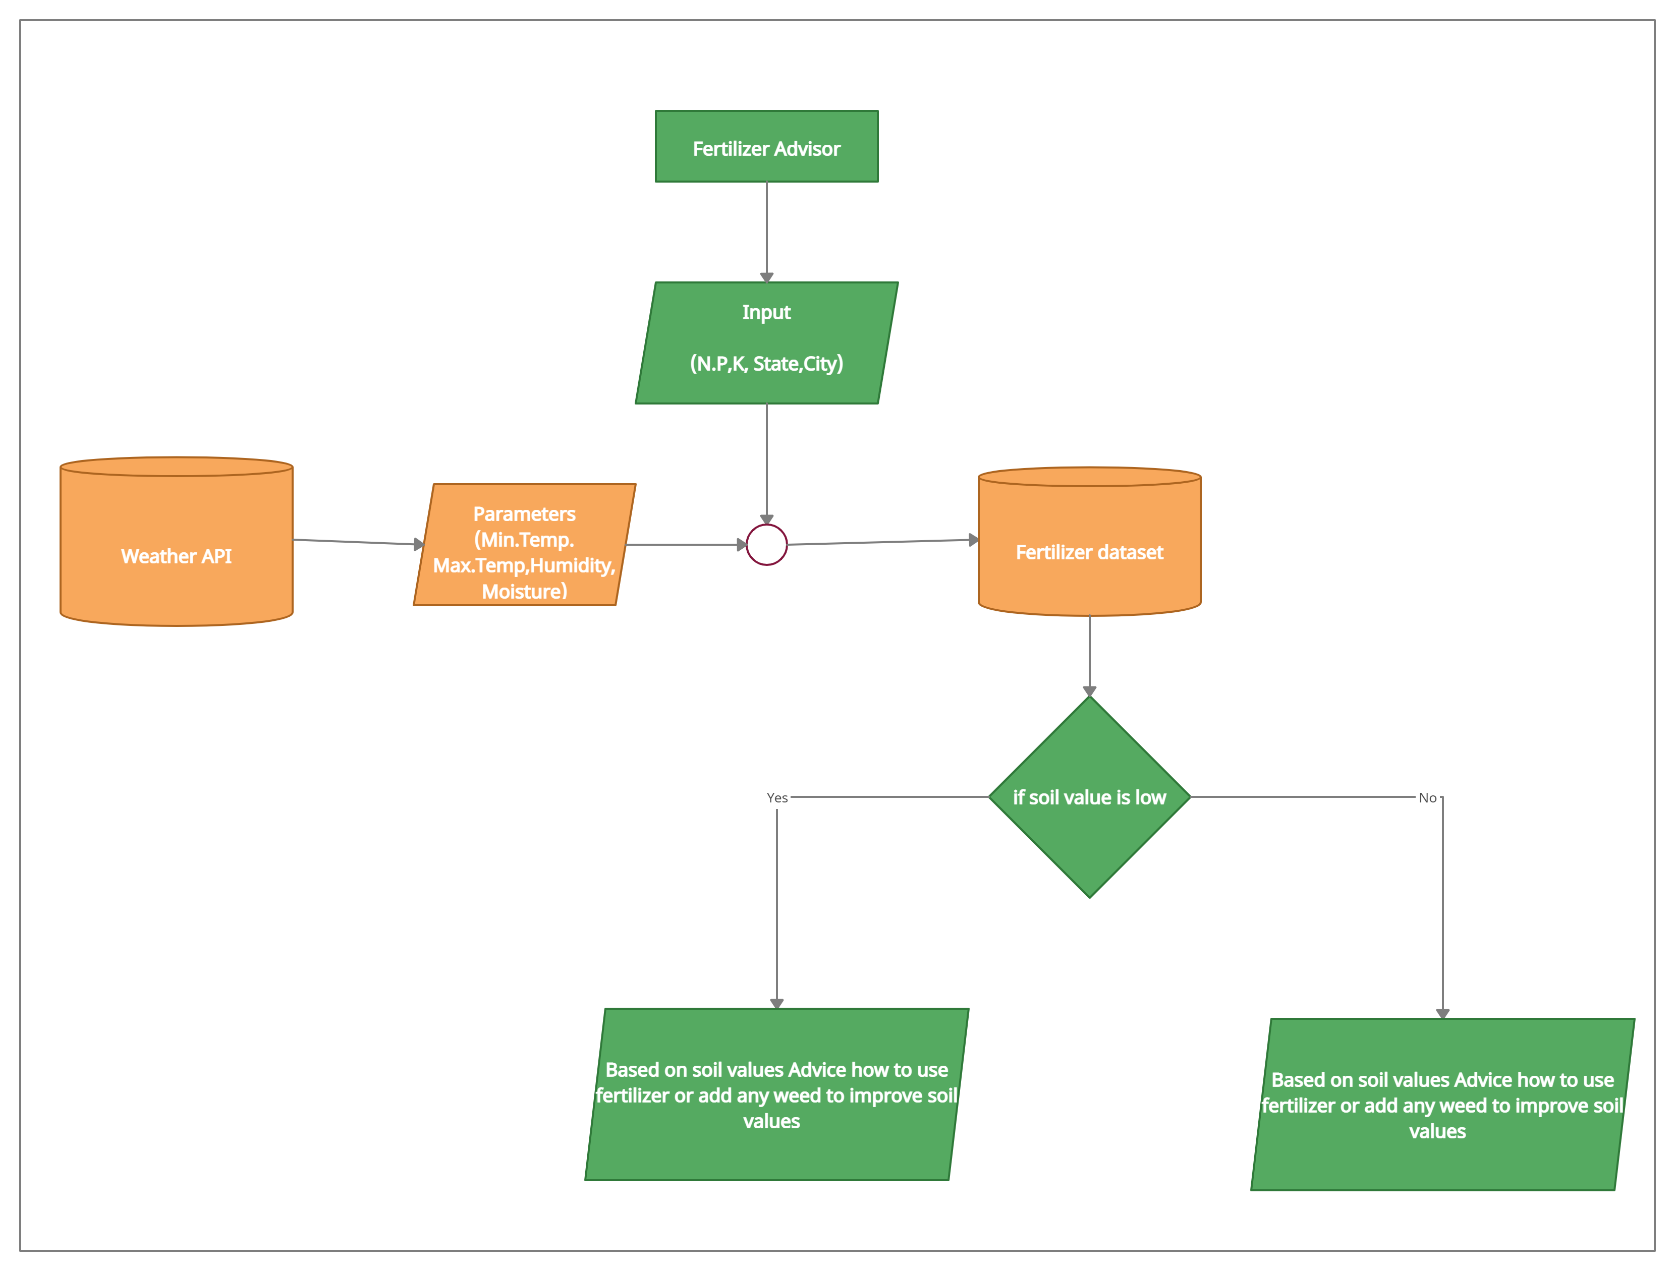
Architecture Diagram Of Fertilizer Advisor

Slide 37
Crop yield Prediction
Crop yield prediction model takes input of state, district, crop, area, season, Production.
The data in Table is data used to predict crop yield based on 7 factors. These 7 factors are state, district, crop, area, season, production by this data.
The sample dataset is used for the crop yield prediction model is shown in following Table.

Slide 38
MSE | R2 Score
0.1841682248672045 | 0.9999993999919369
0.37358624113026034 | 0.9999988090427999
We need to consider the soil factor like Nitrogen, Phosphorous, Potassium, soil pH value and Weather parameters like Rainfall, temperature, moisture and humidity.
We use open weather API to get the current value of Rainfall, moisture, humidity by getting parameters like State and City.
After applying the different machine learning algorithms for the dataset
The Random Forest Regressor Algorithm show the Accuracy 98.31818181818181

Slide 39
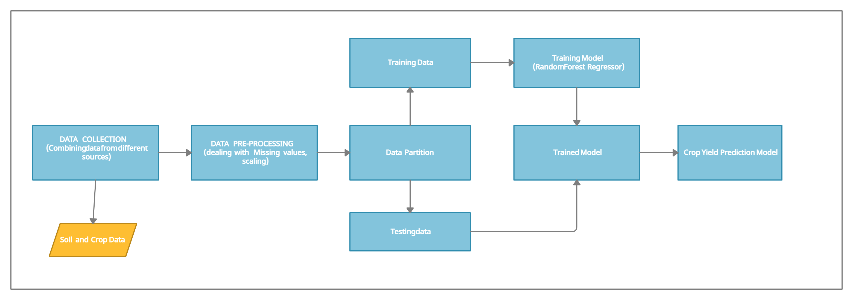
Data Flow Diagram Of Crop Yield Prediction

Slide 40
Crop Yield Prediction system which will use the Random Forest Regressor machine learning algorithm to trained the model and test the model, which will outcomes Crop Yield Prediction Model.
This model will be saved, and the farmers can easily get the crop Yield by giving their farmer soil type characteristics, top soil and pH as the input to the system.
Crop yield method, the model predict the yield in Production/Kg of a particular crop based on soil and weather parameters.

Slide 41
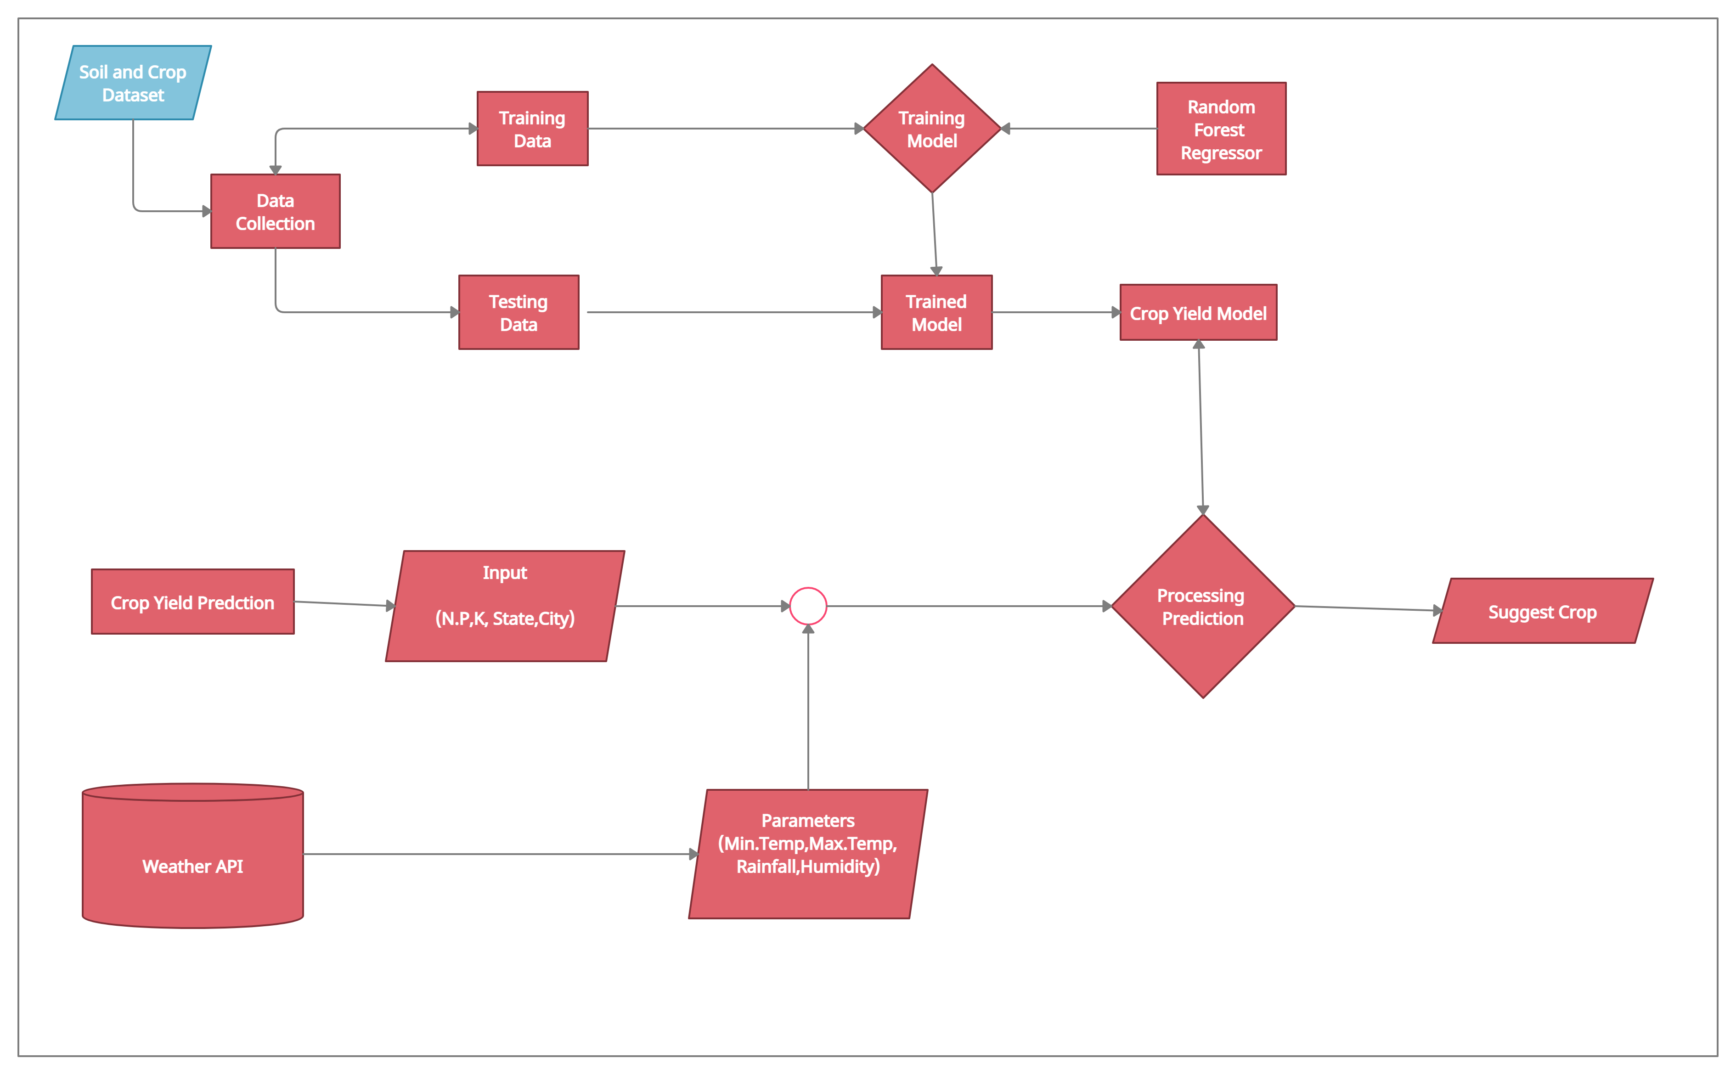
Data Flow Diagram Of Crop Yield Prediction

Slide 42
Deployment in Flask
Flask is a web application framework written in python, in simple terms it helps end users interact with your python code (in this case our ML models) directly from their web browser without needing any libraries,code files, etc
Flask enables you to create web applications very easily, hence enabling you to focus your energy more on other important parts of a ML lifecycle like EDA, feature engineering, etc.
Here in this blog I will give you a walkthrough on how to build a simple web application out of your ML Model and deploying it eventually.

Slide 43
Deployment in Flask
We use Flask micro web framework for deployment the machine learning Model in website and design using HTML, CSS, Bootstrap and JavaScript.
Run the Machine Learning Model like Crop Recommending model and Crop Yield Prediction Model using the pickle python libraries and deployment into website using flask web framework.
Then create a html page program for home page, crop recommending page, crop recommending result page, fertilizer page, fertilizer result page, crop yield page, crop yield result page and about page.
This is page are designed by HTML, CSS , Bootstrap and JavaScript.

Slide 44
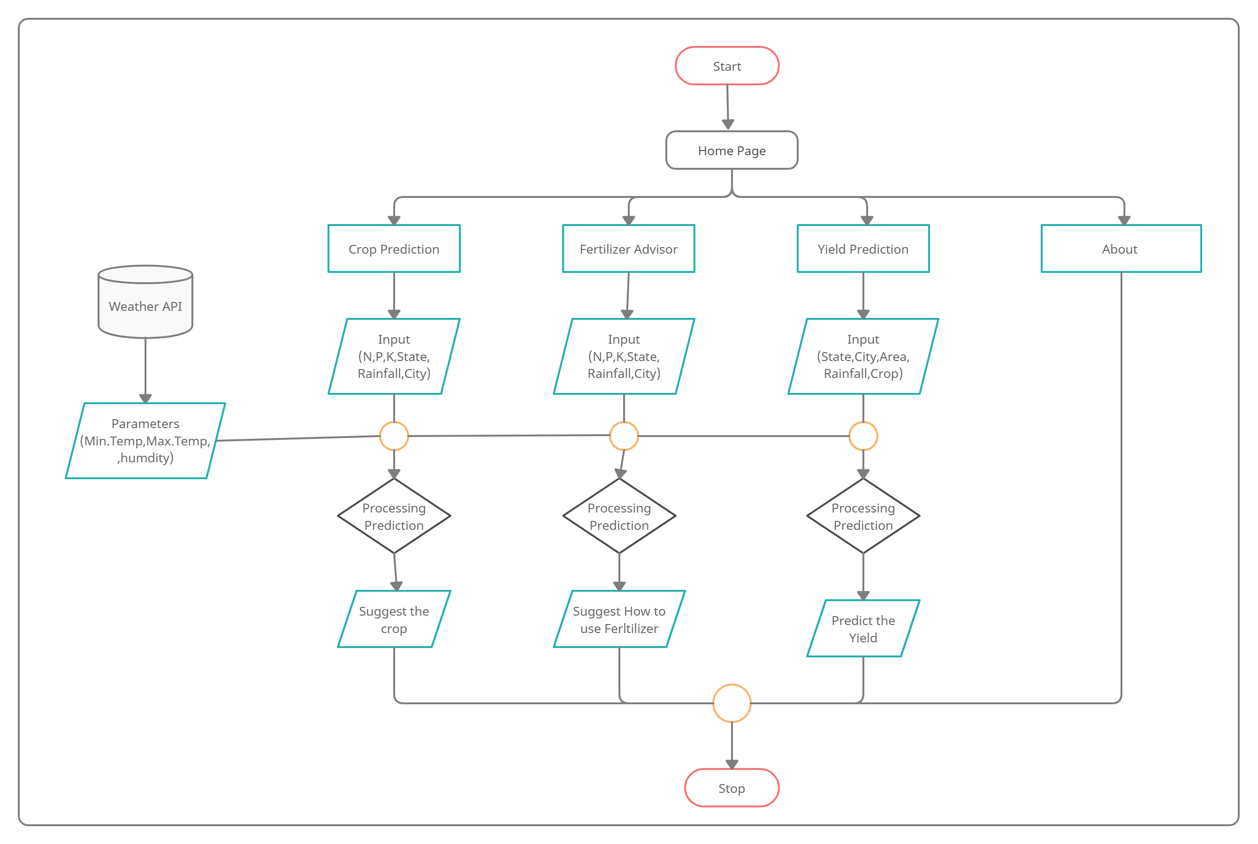
Architectural Design

Slide 45
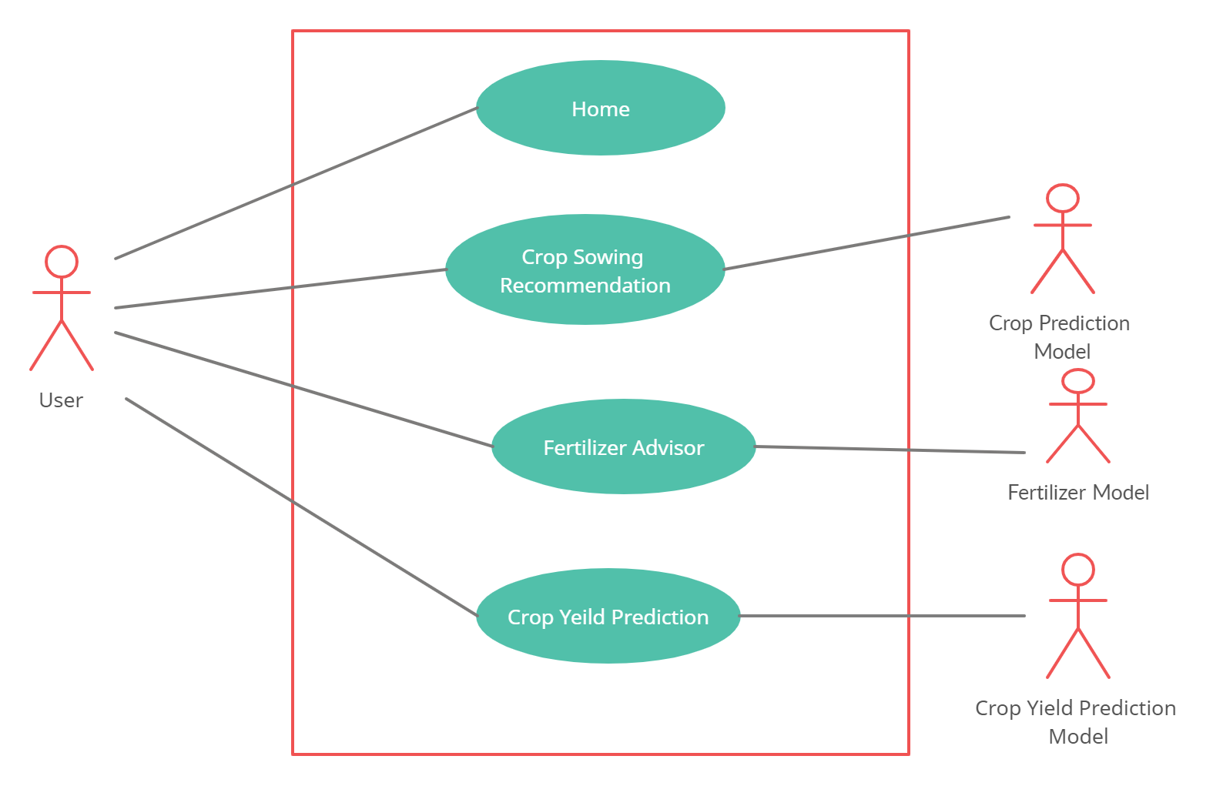
Use Case Diagram

Slide 46
System testing
System Testing is a level of testing that validates the complete and fully integrated software product.
The purpose of a system test is to evaluate the end-to-end system specifications.
Usually, the software is only one element of a larger computer-based system. Ultimately, the software is interfaced with other software/hardware systems.
System test falls under the black box testing category of software testing.

Slide 47
System testing
Data Collection Unit testing performed on each module or block of code during development. Unit Testing is normally done by the programmer who writes the code.
Integration testing done before, during and after integration of a new module into the main software package. This involves testing of each individual code module. One piece of software can contain several modules which are often created by several different programmers. It is crucial to test each module’s effect on the entire program model.
Acceptance testing – beta testing of the product done by the actual end users.

Slide 48





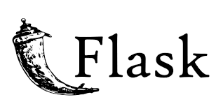
SOFTWARE TECHNOLOGIES USED

Slide 49
Experimental Result
For Crop Selection:
The Random Forest Classification Algorithm show the Accuracy 99.31818181818181

Slide 50
Experimental Result
For Crop Yield Prediction:
MSE | R2 Score
0.1841682248672045 | 0.9999993999919369
0.37358624113026034 | 0.9999988090427999
The Random Forest Regressor Algorithm show the Accuracy 98.31818181818181
Deployment the Model in Website will be easy for the farmer to use.
Farmer use this application to get the crop sowing based on weather and Crop Yield Production

Slide 51
Comparison with Existing System
System Features | Existing System | Harvestify | Agro-Intelligent
Technology used | Machine Learning | Django web framework | Flask web framework
Services | Crop Recommendation | Crop Recommendation and Crop Disease identification | Crop Recommendation, Fertilizer Suggested and Crop Yield Prediction
API | No | Weather API | One Weather API
User Friendly | No | Yes | Yes
Premise Access | Everyone | Authorized person only | Everyone
Programming Language | Python | Python | Python
Arduino board used | Yes | Yes | No

Slide 52
Conclusion and Future development
Crop yield prediction and Crop recommending is successfully predicted.
It also found that the efficient algorithm are obtained by complaining various
machine learning algorithm.
In future developing the android application based on this method can make the
user to use this easily in smart phone and help the user to understand the yield of
the crop, he can find the correct sowing crop based on weather and soil parameters.
Also Add a extra features like leaf disease prediction, smart irrigation, Arduino based smart farming system

Slide 53
References
Dhruv Piyush Parikh , Jugal Jain , Tanishq Gupta and Rishit
Hemant Dabhade, “Machine Learning Based Crop Recommendation System ” in
International Journal of Advanced Research in Science, Communication and
Technology (IJARSCT)
ABHINAV SHARMA, ARPIT JAIN, PRATEEK GUPTA AND VINAY
CHOWDARY, “Machine Learning Applications for Precision Agriculture: A
Comprehensive Review”
A.T.M Shakil Ahamed, Navid Tanzeem Mahmood, Nazmul Hossain,
Mohammad Tanzir Kabir, Kallal Das, Faridur Rahman, Rashedur M Rahman (2015) ,
‘Applying Data Mining Techniques to Predict Annual Yield of Major Crops and
Recommend Planting Different Crops in Different Districts in Bangladesh’ ,
(SNPD) IEEE/ACIS International Conference

Slide 54
References
Rahul Katarya, Ashutosh Raturi, Abhinav Mehndiratta, Abhinav
Thapper , “Impact of Machine Learning Techniques in Precision
Agriculture” in 3rd International Conference on Emerging Technologies in
Computer Engineering: Machine Learning and Internet of Things (ICETCE)
MAMUNUR RASHID, BIFTA SAMA BARI, YUSRI YUSUP, MOHAMAD
ANUAR KAMARUDDIN, AND NUZHAT KHAN, “A Comprehensive Review of Crop
Yield Prediction Using Machine Learning Approaches With Special Emphasis on
Palm Oil Yield Prediction”
Zeel Doshi, Subhash Nadkarni, Rashi Agrawal and Neepa Shah,
“AgroConsultant: Intelligent Crop Recommendation System Using Machine
Learning Algorithms” 2018 Fourth International Conference on Computing
Communication Control and Automation (ICCUBEA)

Slide 55
References
Rakesh Kumar , M.P. Singh, Prabhat Kumar and J.P. Singh, “Crop Selection
Method to Maximize Crop Yield Rate using Machine Learning Technique”, International
Conference on Smart Technologies and Management for Computing, Communication,
Controls, Energy and Materials, 2015
Aruvansh Nigam , Saksham Garg , Archit Agrawal and Parul Agrawal,
“Crop Yield Prediction Using Machine Learning Algorithms” in 2019 Fifth International
Conference on Image Information Processing (ICIIP)
Sai Yasehwanth Chaganti, Prajwal Ainapur, Mayank Singh, “Prediction Based
Smart Farming ” in 2019 2nd International Conference of Computer and Informatics
Engineering (IC2IE)
Talha Siddique, Dipro Barua, Zannatul Ferdous, Amitabha Chakrabarty,
“Automated Farming Prediction” in Intelligent Systems Conference 2017

Slide 56
THANK YOU

